Slide 1
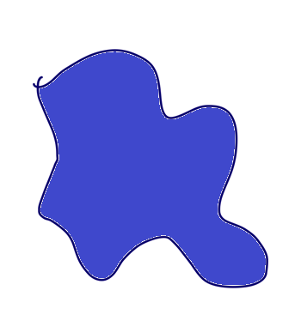





(a)
(b)
$$f_{1}$$
$$f_{1}$$
$$f_{2}$$
$$f_{2}$$

